Slide 2
Thief

Slide 3
Thief

Slide 4
Thief Week 1 lesson 1

Slide 5
S G I Date
Pupil | L.O.: I can develop my understanding of a text.
 | Predict what the book will be about.
 | Justify predictions using evidence from the text.
 | _{Read a section of text.}
 | _{Clarify key vocabulary.}
 | Ask and answer questions about the text.
 | _{Summarise what I have read.}
How has the front cover encouraged you to read the book?

Slide 6
Look at the front cover of Thief! by Malorie Blackman
TTYP:
What does the front cover tell you about the story?
Who do you think the story might be about?
What might happen?
What does the word thief mean?
Where do you think the story might be set?

Slide 7
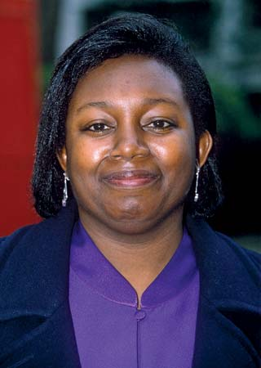
LO: I can analyse a book cover and make predictions.
This half term, we are going to be reading a book by
Malorie Blackman called Thief.

Slide 8
LO: I can analyse a book cover and make predictions.
About the author
Blackman's first book was Not So Stupid!, a collection of horror and science fiction stories for young adults, published in November 1990. Since then, she has written more than 60 children's books, including novels and short-story collections, and also television scripts and a stage play. Her work has won more than 15 awards.
Blackman's award-winning Noughts & Crosses series, exploring love, racism and violence, is set in a fictional alternative Britain. Explaining her choice of title, in a 2007 interview for the BBC’s Blast website, Blackman said that noughts and crosses is "one of those games that nobody ever plays after childhood, because nobody ever wins“. In an interview for The Times, Blackman said that before writing Noughts & Crosses, her protagonists ethnicities had never been central to the plots of her books. She has also said: "I wanted to show black children just getting on with their lives, having adventures, and solving their dilemmas, like the characters in all the books I read as a child.
Blackman eventually decided to address racism directly in later writing.

Slide 9
LO: I can analyse a book cover and make predictions.
TTYP
What predictions can you make about this book based on the front cover?

Slide 10
What predictions can you make based on the front cover?
I think that… I predict… I imagine…
I suppose… I wonder if…
I think… this is because…
I have based this prediction on…
The title makes me think …
The illustration suggests to me …

Slide 11
LO: I can analyse a book cover and make predictions.
Now review the back cover and blurb.
TTP
What do you think of the book now?

Slide 12
LO: I can analyse a book cover and make predictions.
Popular books often get reprinted and republished over time. You may see different editions of a book with alternate front covers.
What do you like about the covers? What don’t you like about them? How would you change the cover Thief cover?

Slide 13
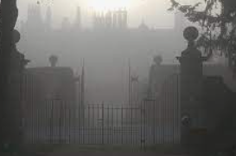
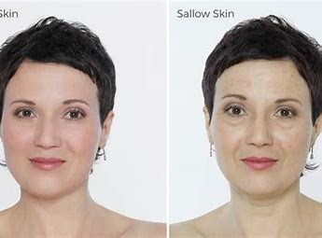
Target Words
exasperation
shrouded
sallow

Slide 14
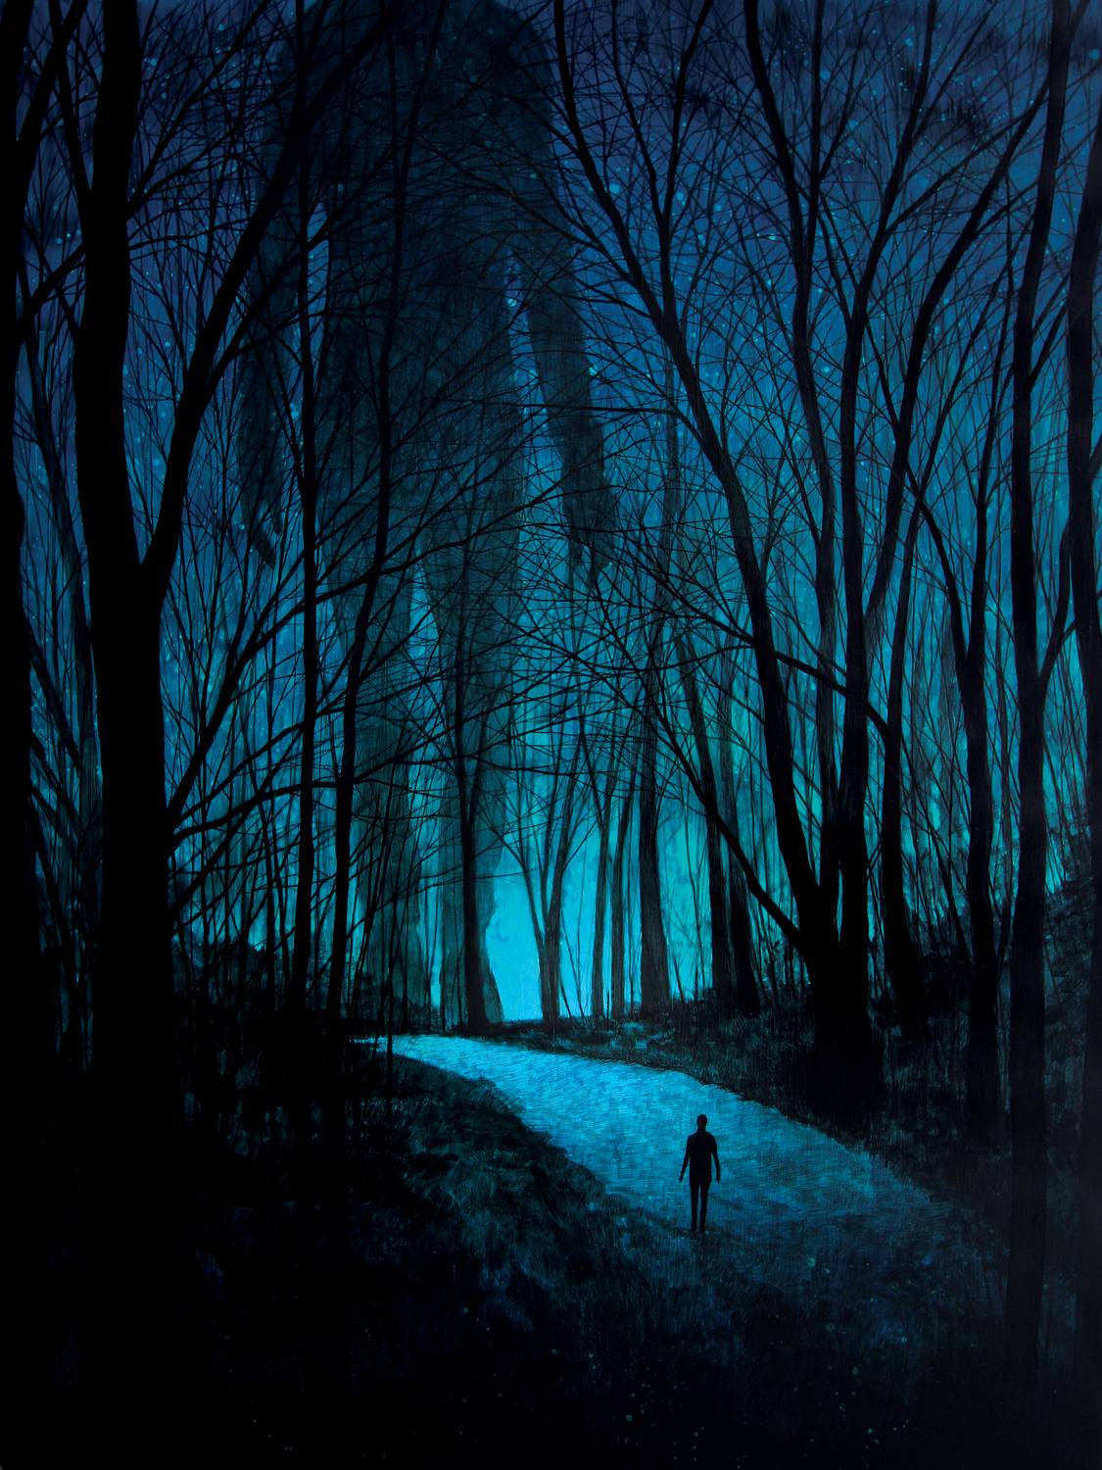
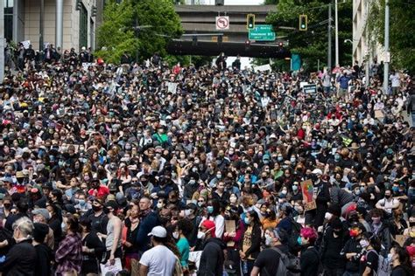
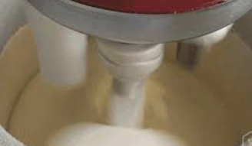
LO: I can analyse a book cover and make predictions.
protested
ominously
churned

Slide 15
Target words – Oxford dictionary definitions
exasperation
A feeling of intense irritation or annoyance.
An adjective to describe a person's face or complexion as an unhealthy yellow or pale brown colour.
Cover or envelop so as to conceal from view.
sallow
shrouded

Slide 16
Target words – Oxford dictionary definitions
protested
Express an objection to what someone has said or done
To suggest that something bad is going to happen.
A strong shake, rotation or movement.
ominously
churned

Slide 17
LO: I can analyse a book cover and make predictions.
Let’s read chapters 1-3
Look out for target words!

Slide 18
S G I Date
Pupil | L.O.: I can develop my understanding of a text.
 | Predict what the book will be about.
 | Justify predictions using evidence from the text.
 | _{Read a section of text.}
 | _{Clarify key vocabulary.}
 | Ask and answer questions about the text.
 | _{Summarise what I have read.}
How has the front cover encouraged you to read the book?
Let’s reflect on the learning we have done in our lesson.

Slide 19
Thief Week 1 lesson 2

Slide 20
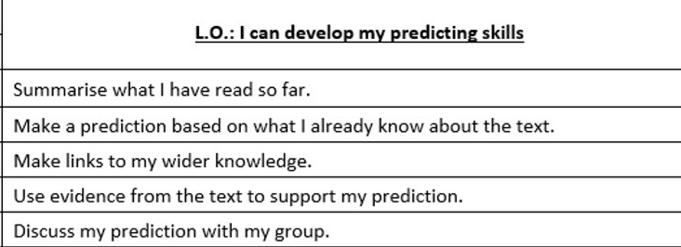
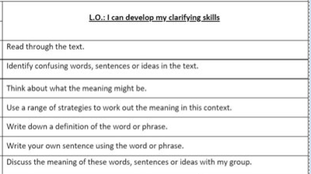
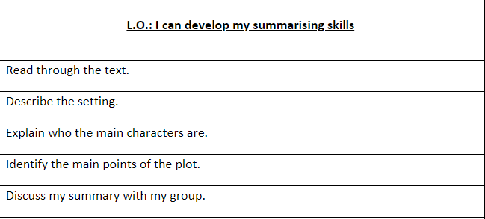
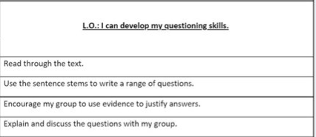
LO: I can develop my comprehension skills.
Read through your Success Criteria.

Slide 21
LO: I can develop my questioning skills.
Use the success criteria to guide you through the skill you are focused on in this lesson. Keep checking back to see if you are on track.

Slide 22
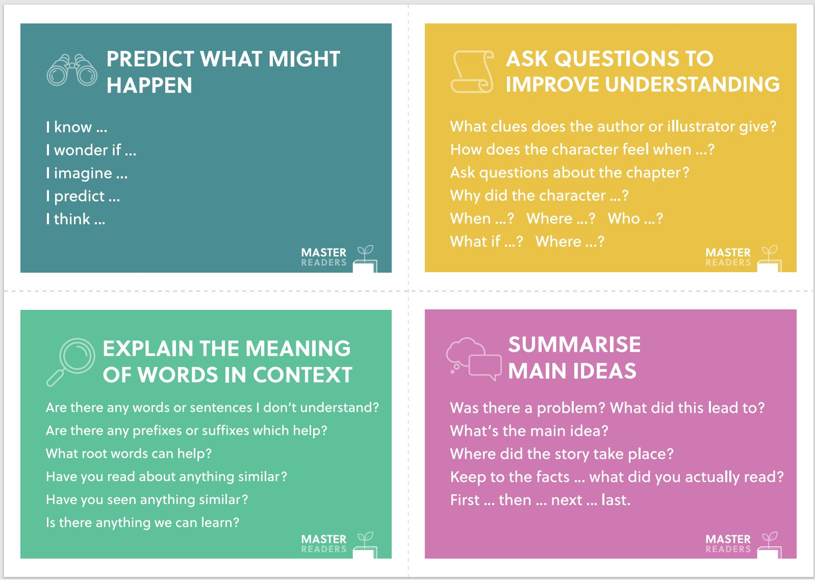
LO: I can develop my questioning skills.
Use the skill cards to help you make effective notes.

Slide 23
LO: I can develop my comprehension skills
Now spend five minutes discussing your notes with your table group.
Can you answer each other’s questions?
Is there anything you disagree with or agree with ?

Slide 24
LO: I can develop my comprehension skills.
Reflect on your learning using your Success Criteria to guide you.

Slide 25
Thief Week 1 lesson 3

Slide 26
LO: I can develop my comprehension skills.

Slide 27
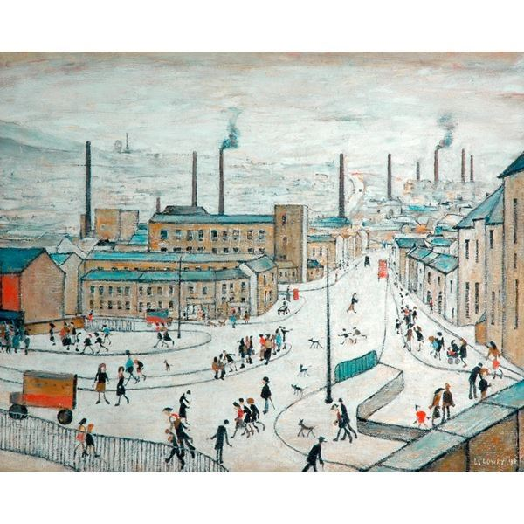
LO: I can develop my comprehension skills.
Retrieve
Which habitat is this picture taken in? Describe it.
Interpret
What will happen to the turtle next? Explain why you think this.
Author/Creator Choice
Why did the photographer take a picture with rubbish in it?

Slide 28
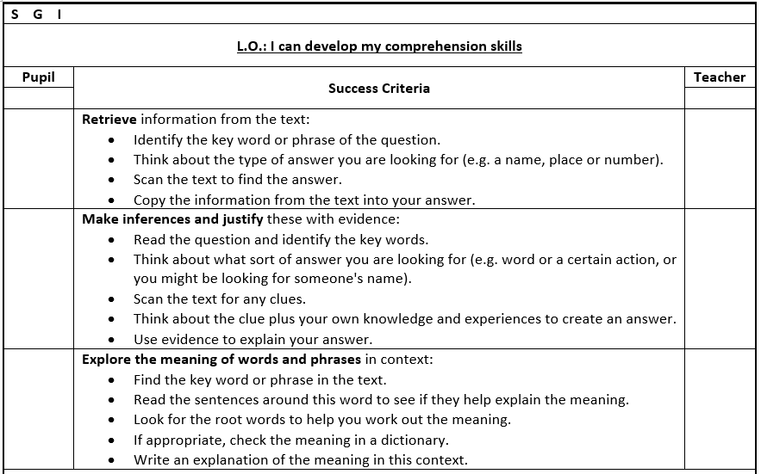
LO: I can develop my comprehension skills.

Slide 29
LO: I can develop my comprehension skills.

Slide 30
LO: I can develop my comprehension skills.
Use the Success Criteria to reflect on your learning. How well are you doing?

Slide 31
Thief Week 1 lesson 4

Slide 32
LO: I can develop my comprehension skills.

Slide 33
LO: I can develop my comprehension skills.

Slide 34
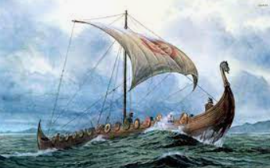
LO: I can develop my comprehension skills.
Retrieve
What can you see in the painting?
Interpret
Where do you think the boat is travelling to?
Choice
Why has the artist chosen to show the strength of the wind and waves in the painting?

Slide 35
LO: I can develop my comprehension skills.
Use the Success Criteria to guide you as you answer questions.

Slide 36
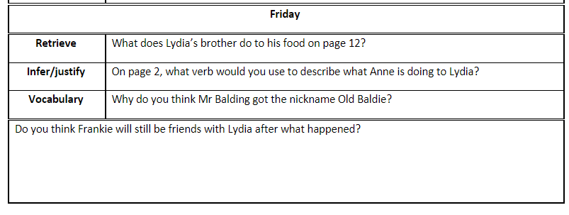
LO: I can develop my comprehension skills.

Slide 37
LO: I can develop my comprehension skills.
How well did you do? Use the Success Criteria to reflect on your learning.

Slide 38
Thief Week 1 lesson 5

